Slide 1
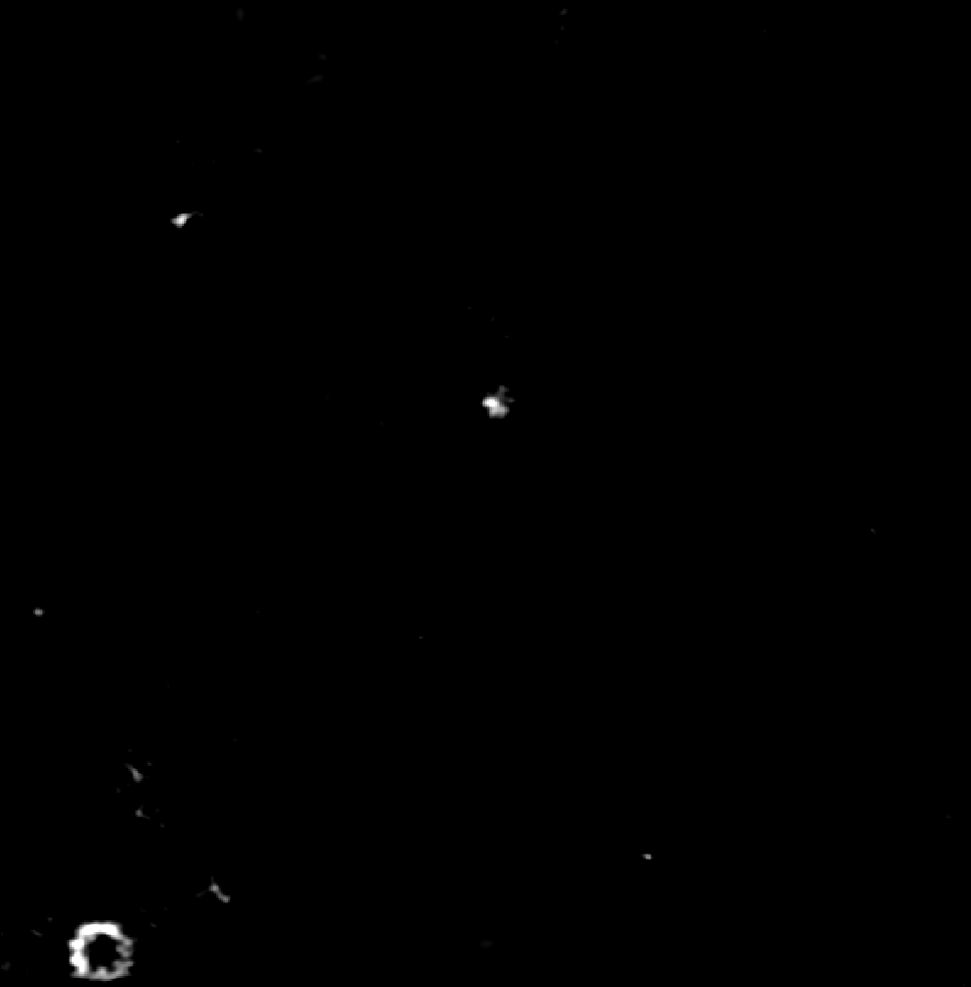
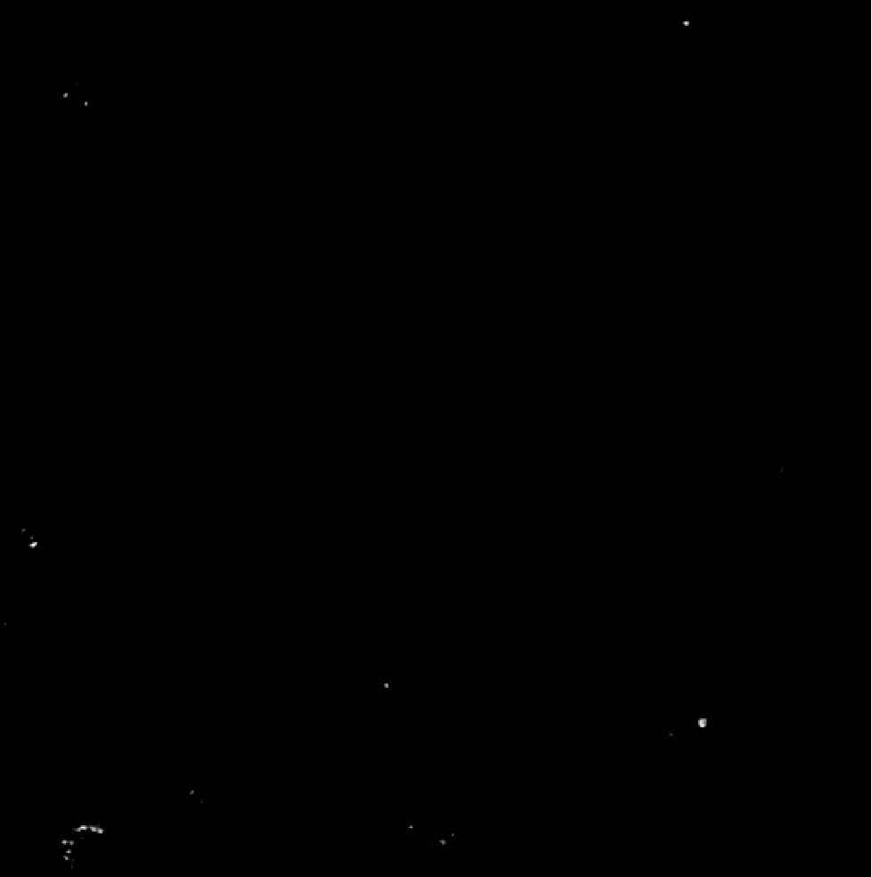
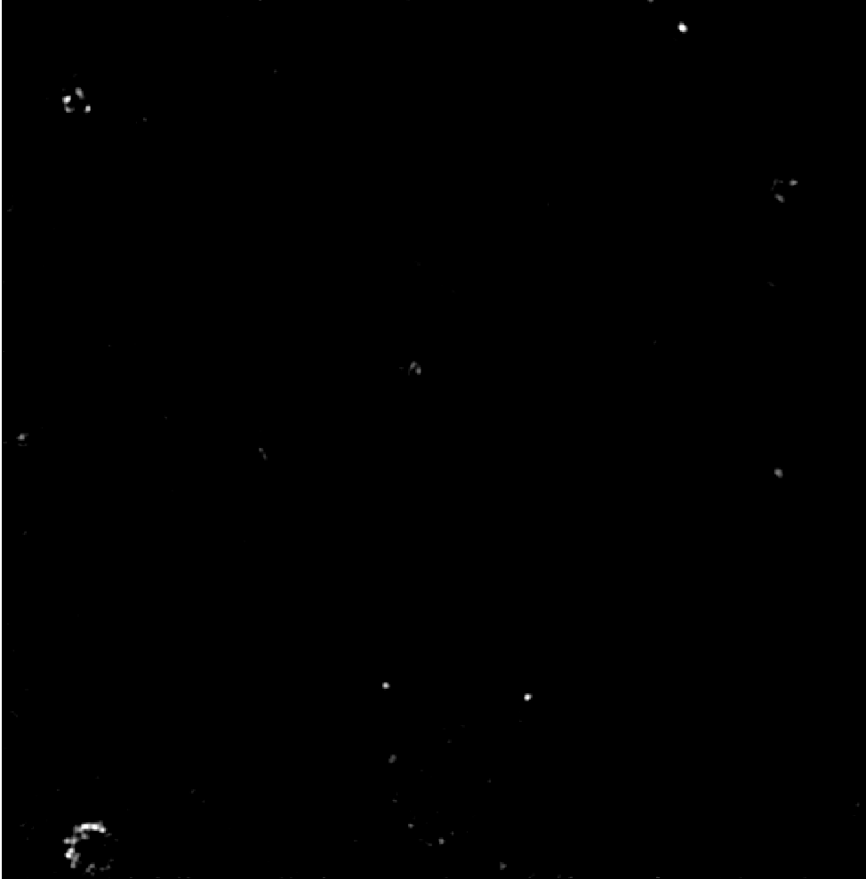
PANORAMA of plasma sample HCR 55 at different times
PANORAMA
Time: 30 min
Count: 13
PANORAMA
Time: 45 min
Count: 20
PANORAMA
Time: 15 min
Count: 9
Scale bar: 10 µm

Slide 2
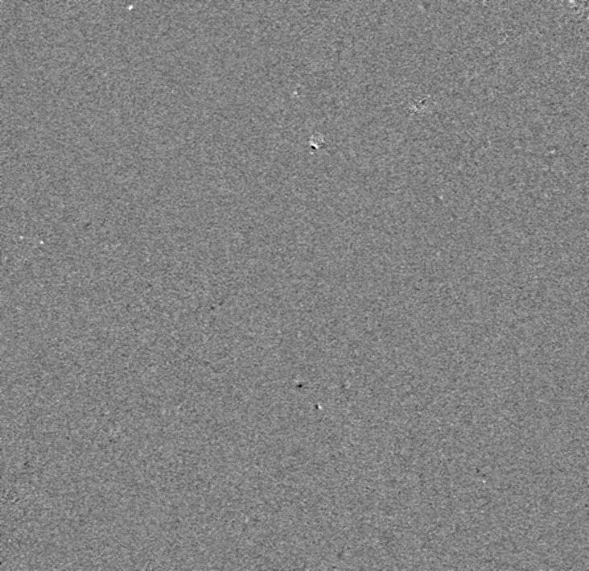
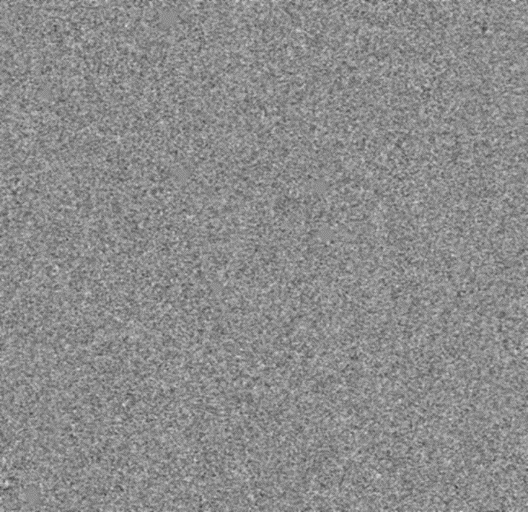
Videos: Plasma samples from 10A and 12A cancerous
Sample 10A
Count: 85
Sample 12A
Count: 94
Video taken at time 90 min
Few exosome-like particles appear.
High number of 1-2 micron size particles.
The Background IR 1±0.0101
Scale Bar: 10 µm

Slide 3
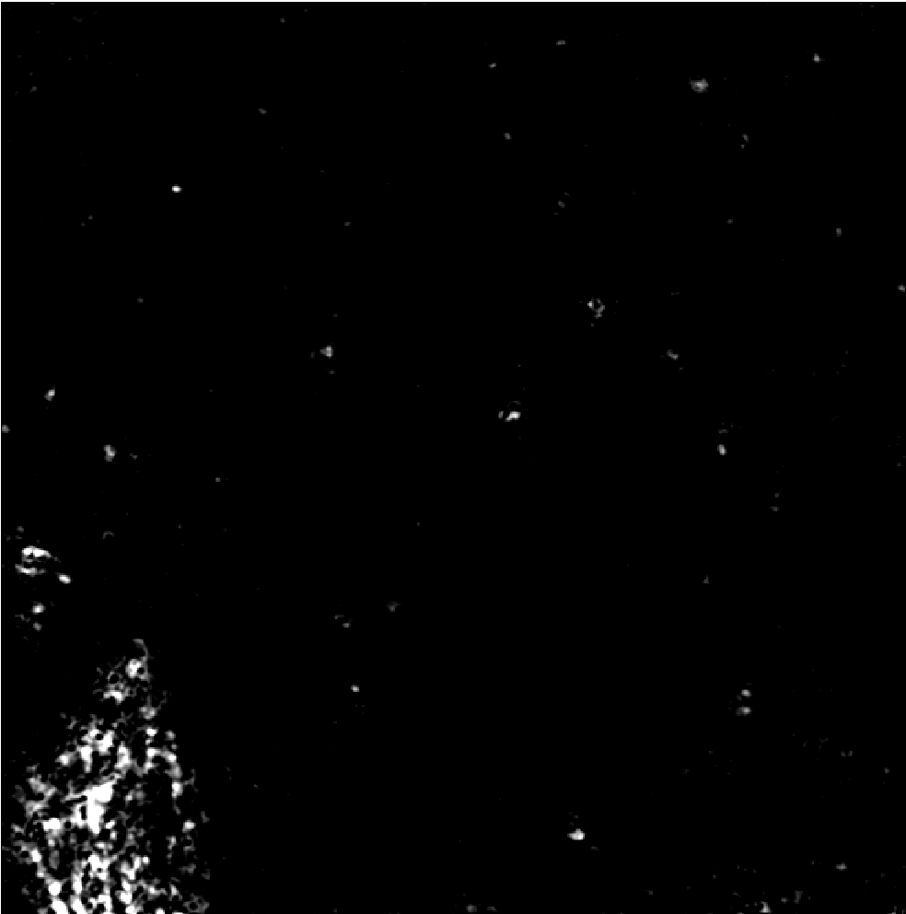
PANORAMA of HCR 55
PANORAMA (IR: 1.24 ± 0.13)
Time: 45 min
Count: 60
No particles left after wash
Cluster showed up
Scale Bar: 10 µm

Slide 4
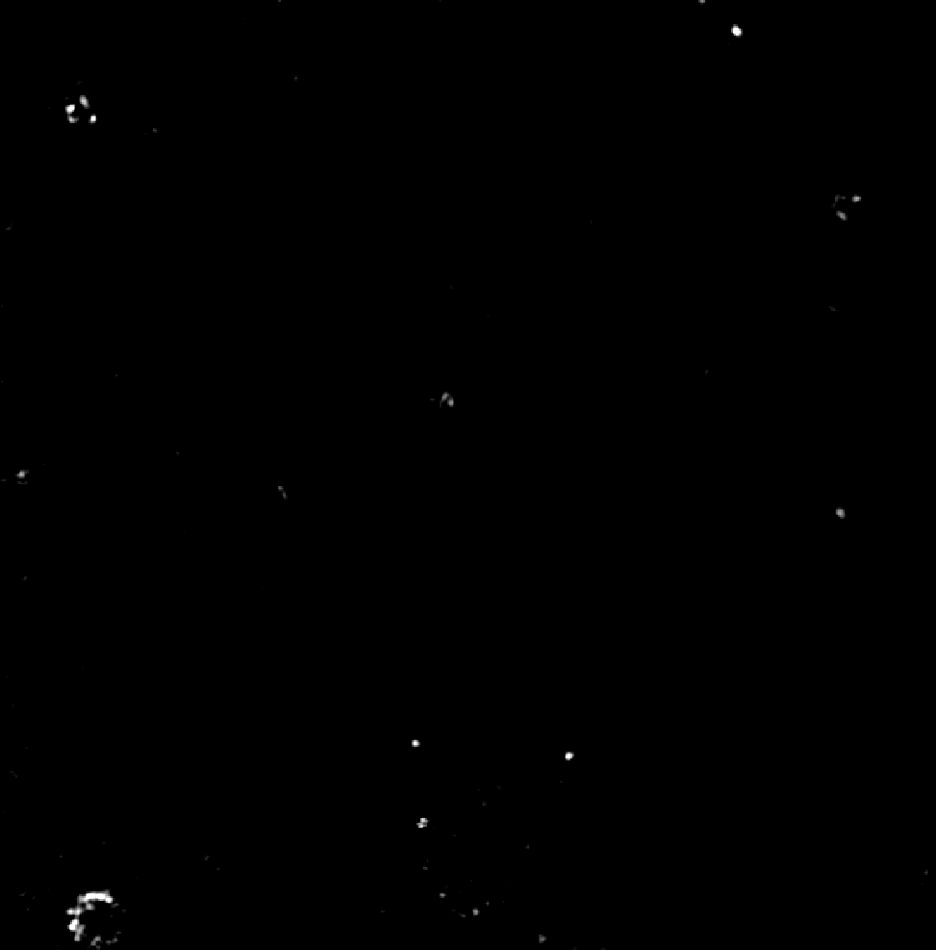
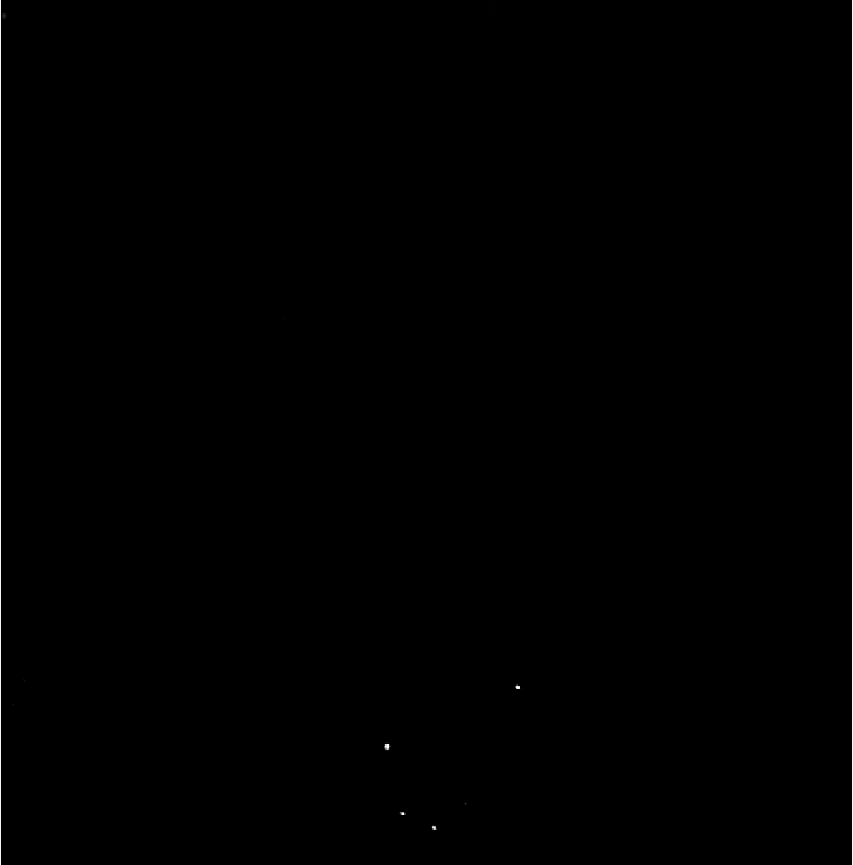
PANORAMA of plasma sample HCR 55 before/after wash
PANORAMA
Time: 45 min
Count: 20
PANORAMA (1.24→250 nm and 1.28→350 nm)
Time: 45 min wash
Count: 4
20 % of detected particles captured after wash
Scale bar: 10 µm

